Slide 1
Artificial Intelligence
3: Uninformed Search
Alvin Tjondrowiguno

Slide 2
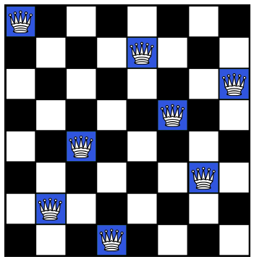
Previously: Goal-Based Agents
States : Any arrangement of 0-8 queens on the board
Initial state : An empty board
Actions : Add queen, remove queen
Transition : Board updates model
Goal test : 8 queens on the board with none attacking each other
Path cost : 0 (it doesn’t matter how many moves are taken, as long as the solution is found)

Slide 3

Previously: Search Trees
...
...
...
...
...
...

Slide 4
Uninformed Search
A search strategy where no domain knowledge (about the goal) is used
No information about the states beyond the problem definition (as opposed to Informed Search)
Also called “blind search”
Since there are no domain knowledge to be used, the idea is to explore the state space (via the search tree)

Slide 5
Uninformed Search
Uninformed search strategies:
Breadth-First Search (BFS)
Uniform-Cost Search (UCS)
Depth-First Search (DFS)
Depth-Limited Search (DLS)
Iterative Deepening Search (IDS)

Slide 6
Breadth-First Search Strategies

Slide 7
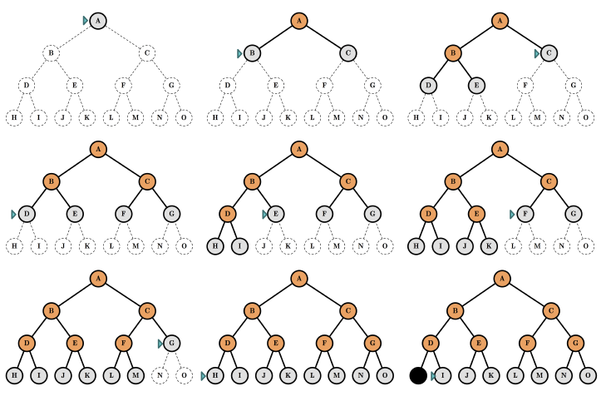
Breadth-First Search: Mechanics

Slide 8
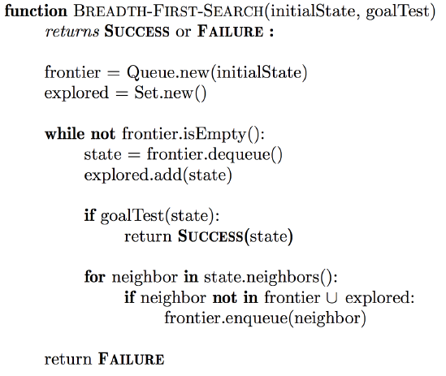
Breadth-First Search: Algorithm

Slide 9
Breadth-First Search: Analysis
Evaluation of the search strategy:
Completeness: Yes, as long as the branching factor is finite
Optimality: Yes, if path cost is the same for all steps
Time complexity: Exponentially High
Space complexity: Exponentially High
Implementation: Frontier is stored in a queue

Slide 10
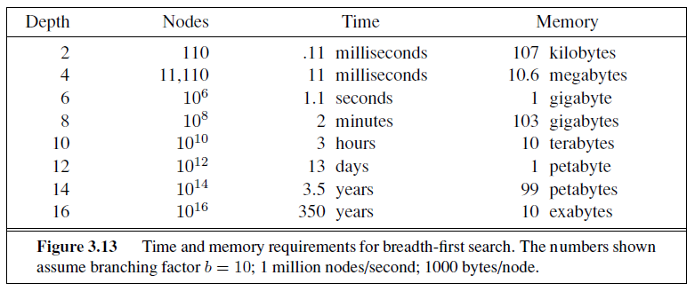
Breadth-First Search: Analysis
In essence, BFS cannot solve exponential-complexity search problems, except for the smallest instances.

Slide 11
Depth-First Search Strategies

Slide 12
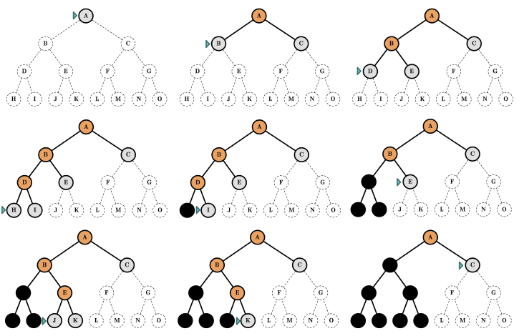
Depth-First Search: Mechanics

Slide 13
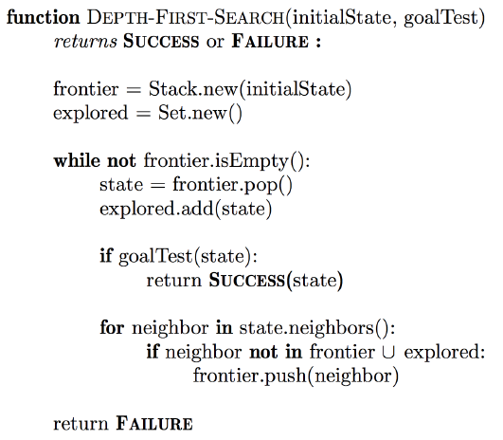
Depth-First Search: Algorithm

Slide 14
Depth-First Search: Analysis
Evaluation of the search strategy:
Completeness: No (on infinite-depth state spaces)
Optimality: No
Time complexity: Exponentially High
Space complexity: Linear (reasonably low!)
Only need to store a single path from root to leaf, plus unexpanded non-leafs
Implementation: Frontier is stored in a stack

Slide 15
Iterative Deepening Search: Idea
A depth-limited search done with increasing depth limit l
Iteratively increase l until the DLS returns the shallowest solution
Combines the strengths of BFS and DFS:
BFS is complete and optimal
DFS has low space complexity
In practice, re-generating the upper level nodes multiple times is not too costly, because the bulk of the tree nodes are at the bottom level

Slide 16
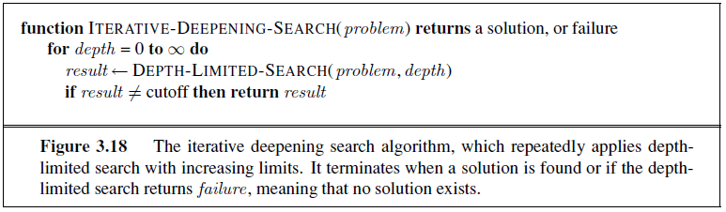
Iterative Deepening Search: Algorithm

Slide 17

Iterative Deepening Search: Mechanics

Slide 18
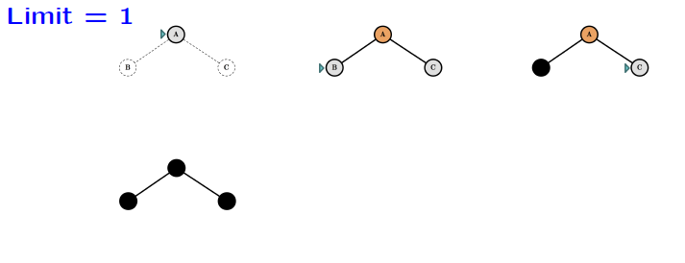
Iterative Deepening Search: Mechanics

Slide 19
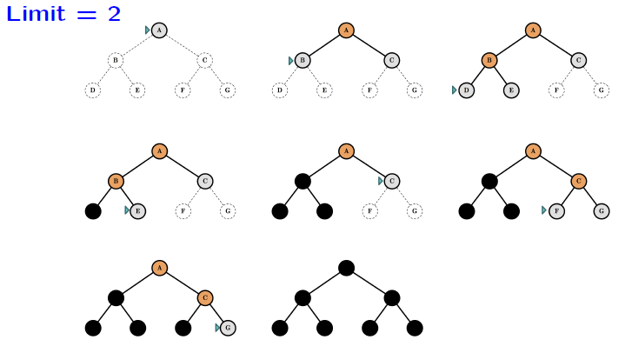
Iterative Deepening Search: Mechanics

Slide 20
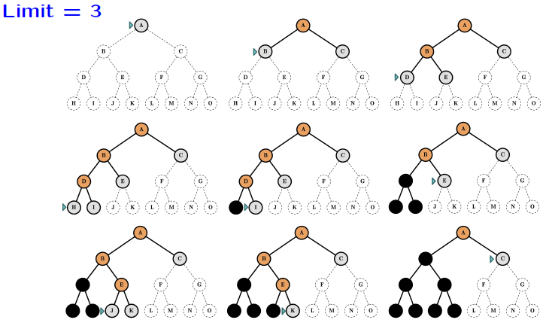
Iterative Deepening Search: Mechanics

Slide 21
Iterative Deepening Search: Analysis
Evaluation of the search strategy:
Completeness: Yes (BFS)
Optimality: Yes (BFS)
Time complexity: Exponentially High
Space complexity: Low (DFS)

Slide 22
Backtracking

Slide 23

State Representation
In the classical search problems, a state is considered to be a black box, which has no internal structure
At least, not in regards to our search strategies
A goal state is a function that takes states (as a whole) as an input
This concept is called the atomic representation of states

Slide 24
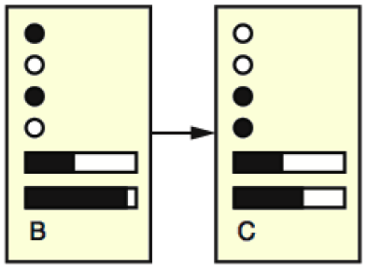
State Representation
In a more detailed representation, a state can have attribute value properties
A goal state is a set of constraints specifying allowed combinations of values
This concept is called the factored representation of states

Slide 25
Constraint Satisfaction Problem
Constraint Satisfaction Problem (CSP) is a type of problem that uses factored representation of states
CSP is defined by three components:
A set of variables: X = {X₁, X₂, …, X_{n}}
A set of domains for each variable: D = {D₁, D₂, …, D_{n}}
A set of constraints C that specify allowed combinations of values of the variables
Solving a CSP means finding the variable assignments that satisfy all constraints
The basic search algorithm to solve CSPs is called Backtracking Search

Slide 26
Backtracking Search
Backtracking search is a method that consists of 2 components:
Depth-first search
States: Partial variable assignments
Initial state: Empty assignment
Actions: Assigning a value to a variable
Goal test: The test whether current assignments satisfy all constraints
Constraint propagation
Only consider values that do not conflict with previous assignments
Essentially reducing the domains for other variables while assigning values
If there are unassigned variables but there are no possible assignments, backtrack

Slide 27
State Space Reduction

Slide 28
Uninformed Search Strategies
So far, neither BFS-based strategies nor DFS-based strategies have solved the exponential time complexity problem
Since most non-trivial problem have exponential-sized state space
However, it may be impossible to avoid, since any algorithm that explores the state space completely will always have to visit every state
Nothing beats an algorithm that completely evaluates every state!
One possible workaround is to modify the state space definition, with the purpose of reducing the size of the state space

Slide 29
Recall: 8-Queen Problem
States : Any arrangement of 0-8 queens on the board
Initial state : An empty board
Actions : Add queen, remove queen
Transition : Board updates model
Goal test : 8 queens on the board with none attacking each other
Path cost : 0 (it doesn’t matter how many moves are taken, as long as the solution is found)

Slide 30
8-Queen Problem
In practice, a single state is most likely represented as an 8x8 (boolean) matrix
A single action (adding / removing a queen) is represented as flipping one value inside the matrix
The state space / search tree has:
Branching factor b = 64
Maximum depth of the tree m = 8
Depth of the shallowest solution d = 8
Total number of possible states = 1.8 x 10¹⁴

Slide 31
8-Queen Problem
Consider a new definition of the state space:
States : A vector of length 8 containing integers in the range 1-8 A number on the i^{th} position represents the row number of the queen placed on the i^{th} column
Initial state : [ 1 1 1 1 1 1 1 1 ]
Actions : Change one number in the vector into another number (1-8)
Transition : Implicit
Goal test : 8 queens on the board with none attacking each other
Path cost : 0

Slide 32
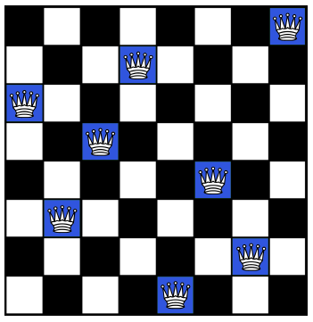
Example
8
8
7
7
6
6
5
5
4
4
3
3
2
2
1
1
[ 8 2 4 1 7 5 3 6 ]
[ 6 3 5 7 1 4 2 8 ]

Slide 33
Search Tree
[ 1 1 1 1 1 1 1 1 ]
[ 2 1 1 1 1 1 1 1 ]
[ 3 1 1 1 1 1 1 1 ]
...
[ 1 1 1 1 1 1 1 8 ]
Branching factor b = 7 * 8 = 56
Maximum depth of the tree m = 7
Depth of the shallowest solution d = 7
Total number of possible states = 8⁸ ≈ 1.7 x 10⁷
Can still be reduced even further!

Slide 34
State Space Reduction
State space reduction techniques are very case-specific
Not all problems can be reduced
Good workaround to turn the exponential state space into something manageable in practice
The state space most likely still has exponential size
Make sure the goal still exists and is reachable in the new state space
Optimality should also be preserved, if applicable

Slide 35
Thank you for listening

